Slide 1
Introduction to Bioinformatics
Lee Katz, PhD

Slide 2
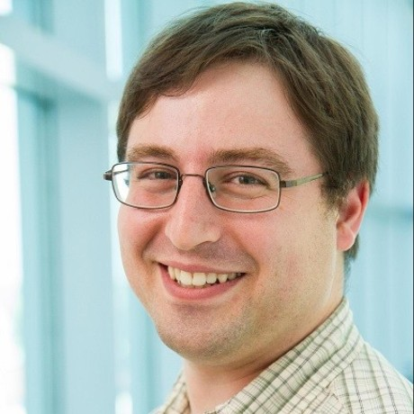
Who are your teachers?
Dr. Katz
👴 At CDC for 10+ years
👨‍🔬 Senior bioinformatician, Enteric Diseases Laboratory Branch
🎙 Podcasting in free time
🐝 GA Tech PhD Bioinformatics
🦅 BS Biology Emory
👩‍👧‍👦👨‍👦 3 young kids
Notes:
Adjunct at UGA
Part time instructor at GSU

Slide 3
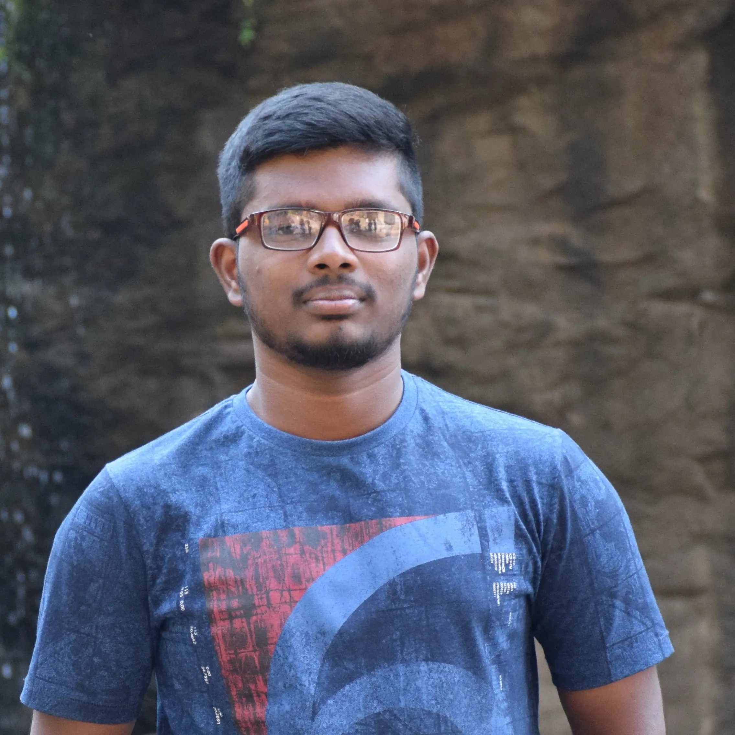
Who is your TA?
Sai Rohith Kota
M.S., Data Science conc. in Big Data and Machine Learning
Interests: Data Analysis, Machine Learning
Hobbies: Ping-pong, Anime and Cricket

Slide 4
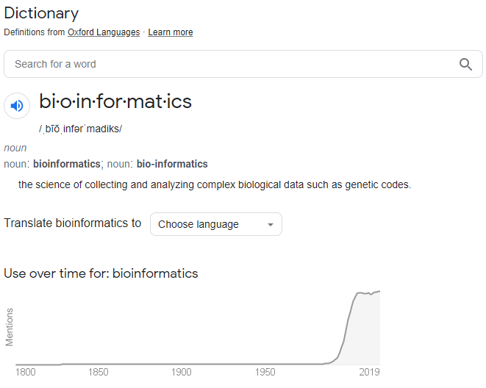
What is bioinformatics
Using computers to solve genetic problems
The interface between computers and biology
A service
“Can you tell me if my reads passed Q/C?”
“I have a list of genes. Can you download them for me?”
A science
“Can you give me some idea of why this bacterium is resistant to ampicillin?”
“How fast is SARS-CoV-2 evolving?”

Slide 5

What is bioinformatics: class poll
Notes:
Ask the class what they actually think bioinformatics is.

Slide 6

“What’s in it for me?”
Great careers in different sectors
Government
Genomic epidemiology
Academia
Strengthen your research with computation
Industry
Pharmaceutical development
Notes:
CDC needs bioinformaticians and so hopefully you all consider the government route

Slide 7

What will do you do when you grow up: poll
What kind of profession do you want to have after school?
Notes:
Ask class what they want to be when they grow up

Slide 8
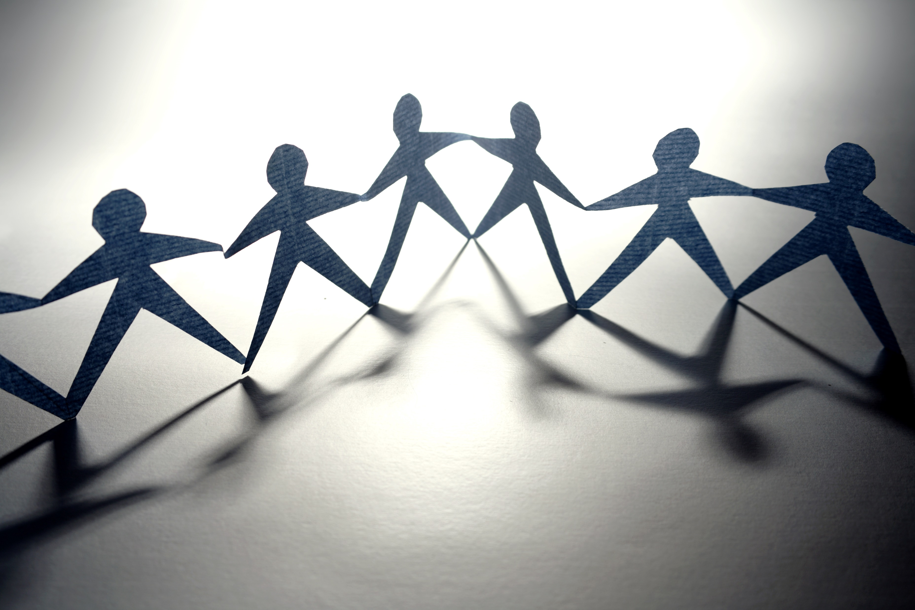
Backgrounds before bioinformatics
People in bioinformatics come from many backgrounds such as
Biology
Computer science
Statistics
Engineering
Mathematics
Other

Slide 9

Backgrounds before bioinformatics: class poll
What is your background?
What is your undergraduate major in?

Slide 10
Guide to this course
🗺

Slide 11
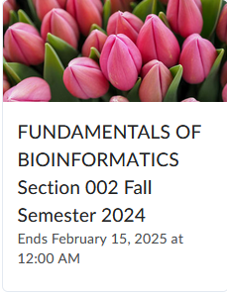
iCollege
Does everyone know how to get to iCollege?
Contents
Syllabus
Recordings
Calendar
Announcements
It is your responsibility to check iCollege at least once a day

Slide 12
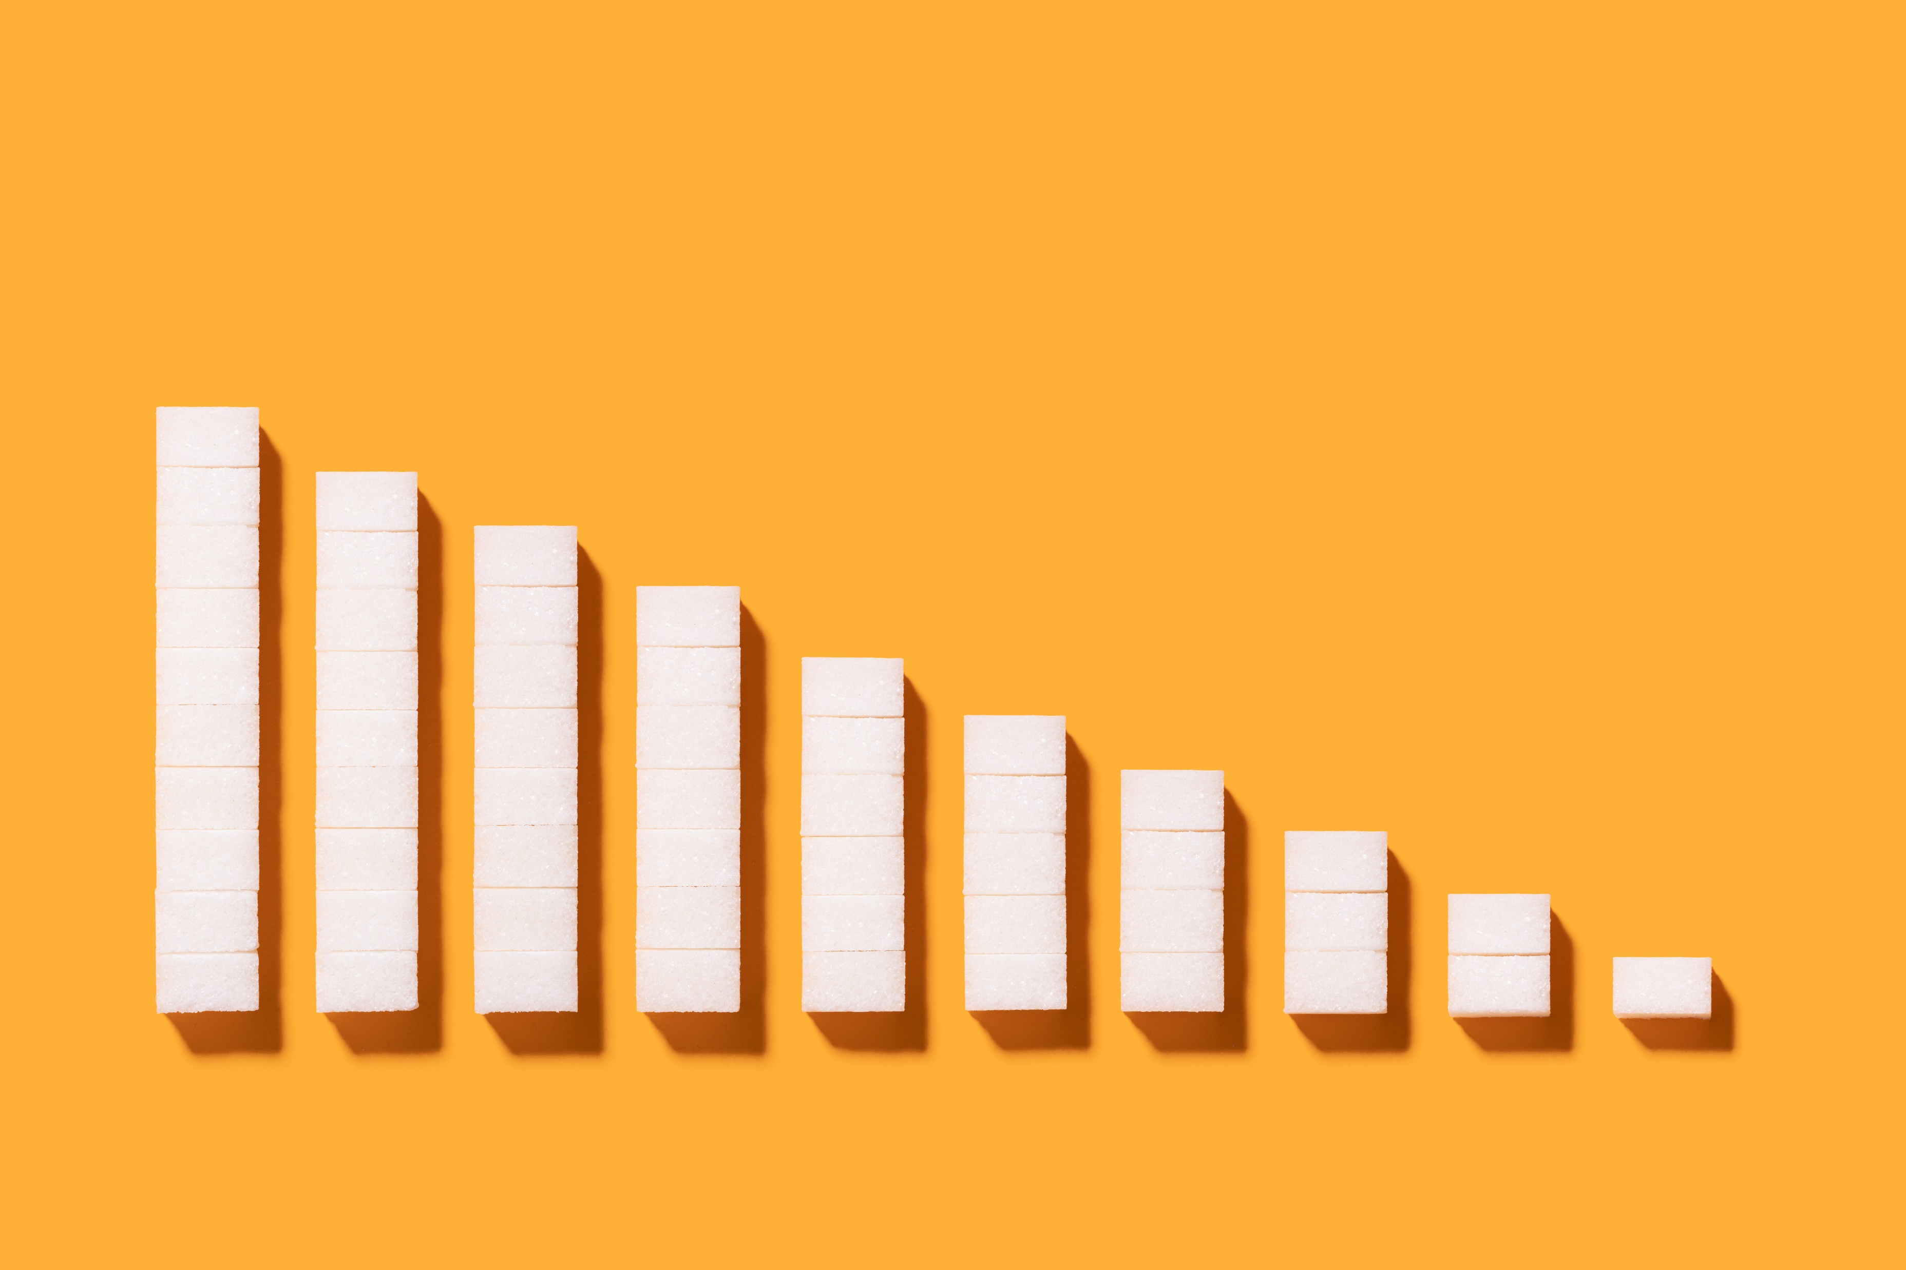
Breakdown of the course
Grades
50% participation
40% activities
10% Final exam
Asynchronous week
Live lecture
=> Recorded lecture
Activity
Final exam

Slide 13
Topics
Basic Linux
Computing basics
Bioinformatics basics
Sequencing
Databases
Alignment
Phylogeny
BLAST
mapping
Genome characterization
Assembly
Gene prediction
Gene annotation
If we have time
Basics of Evolution
Metagenomics
If we have even more free time!
… a topic of your choice

Slide 14

How to learn from this class
Participate in the course
Do the weekly activity
Ask questions
Be resourceful
Activities are open book, open Internet.
Work with your peers
Know that ChatGPT often gets it wrong

Slide 15
Office hours
Either:
12pm - 1pm Mondays
2:30pm – 3:30pm Tuesdays
12pm - 1pm Wednesdays
11 am – 12 pm Thursdays
15-minute rule
We can revisit hours to see what suits you best
Notes:
If no one shows up in 15 minutes, office hours are canceled without notification

Slide 16
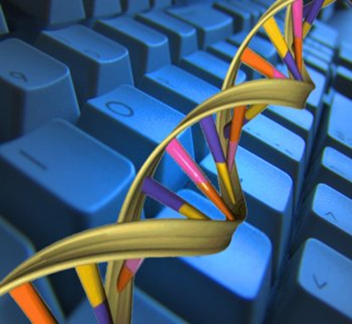
Questions so far?

Slide 17
What is bioinformatics
Jeff Gauthier, Antony T Vincent, Steve J Charette, Nicolas Derome, A brief history of bioinformatics, Briefings in Bioinformatics, Volume 20, Issue 6, November 2019, Pages 1981–1996, https://doi.org/10.1093/bib/bby063

Slide 18
What is bioinformatics
Some attempts at definition
Interface between biology and computer science
the science of collecting and analyzing complex biological data such as genetic codes.
Other definitions at https://www.genome.gov/genetics-glossary/Bioinformatics

Slide 19
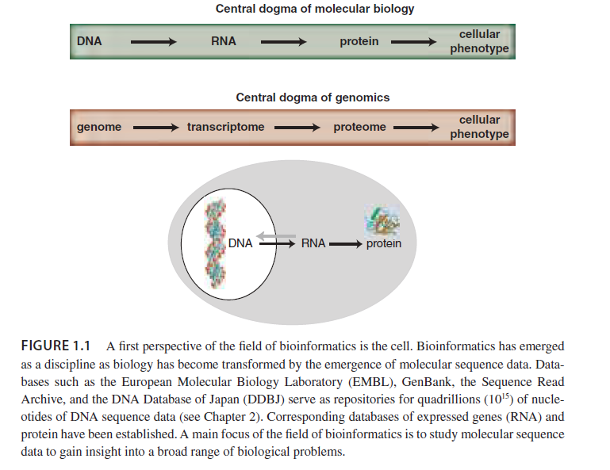
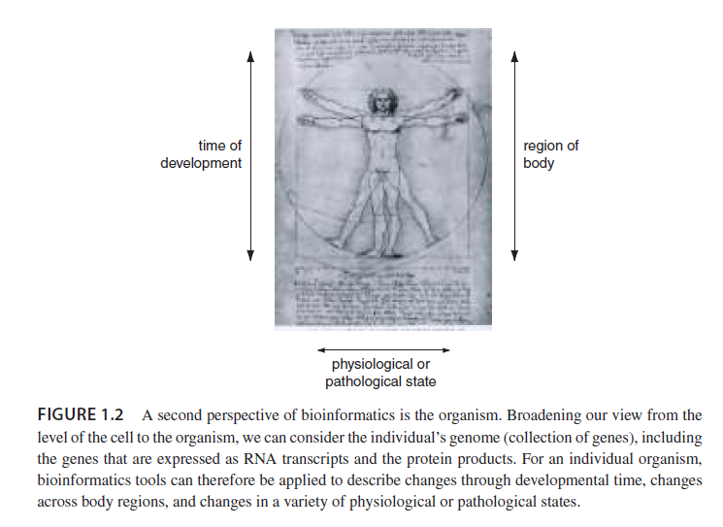
What is bioinformatics?

Slide 20
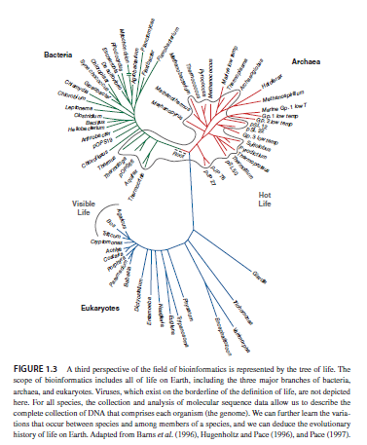
What is bioinformatics?

Slide 21
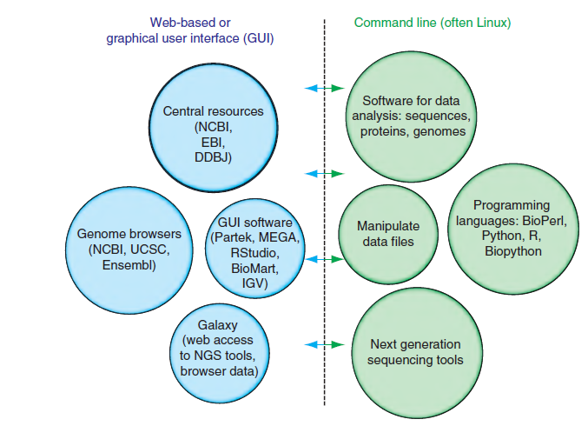
Dichotomy of bioinformatics
Notes:
Is either side more legit? No. They each bring something valuable to the table.
We will try to teach both sides of this equation in this class.
Table 1.1 for some equivalencies

Slide 22
Are we going to be programming in this class?
NO
* but it’s helpful

Slide 23
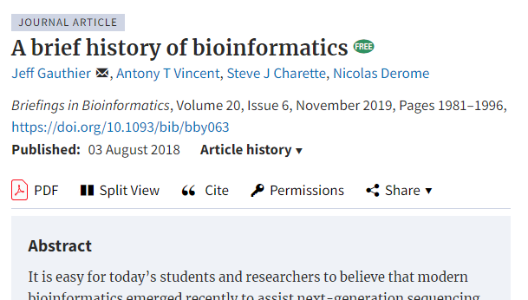
Notes:
How did we get here? A brief history.

Slide 24
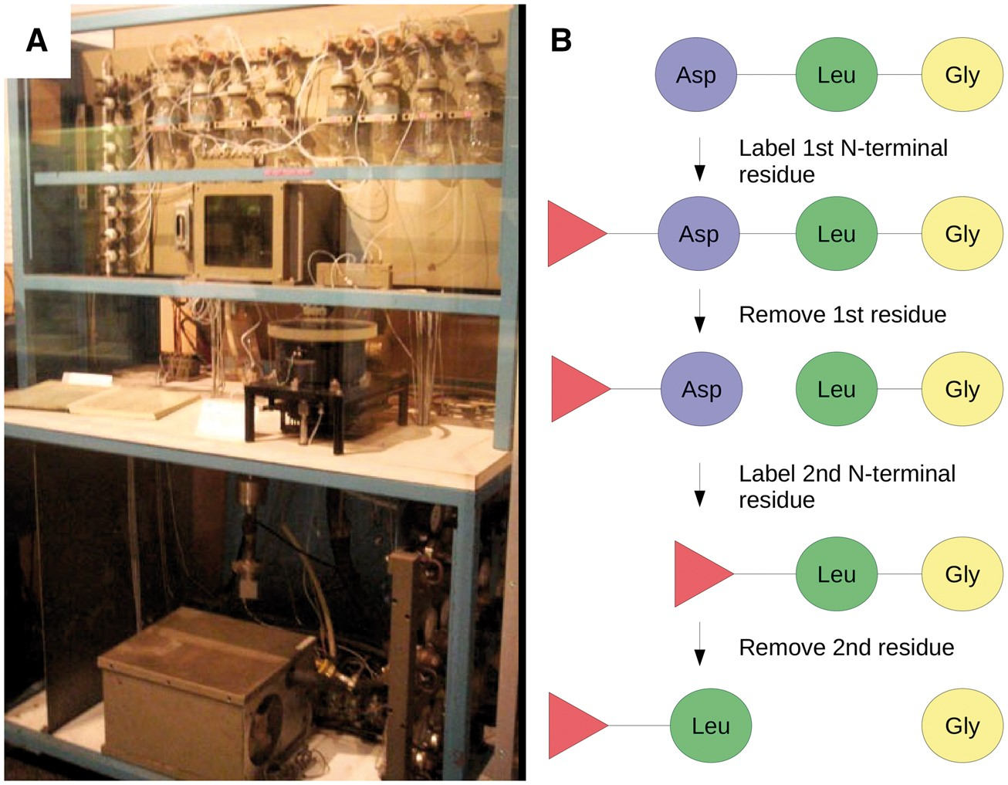
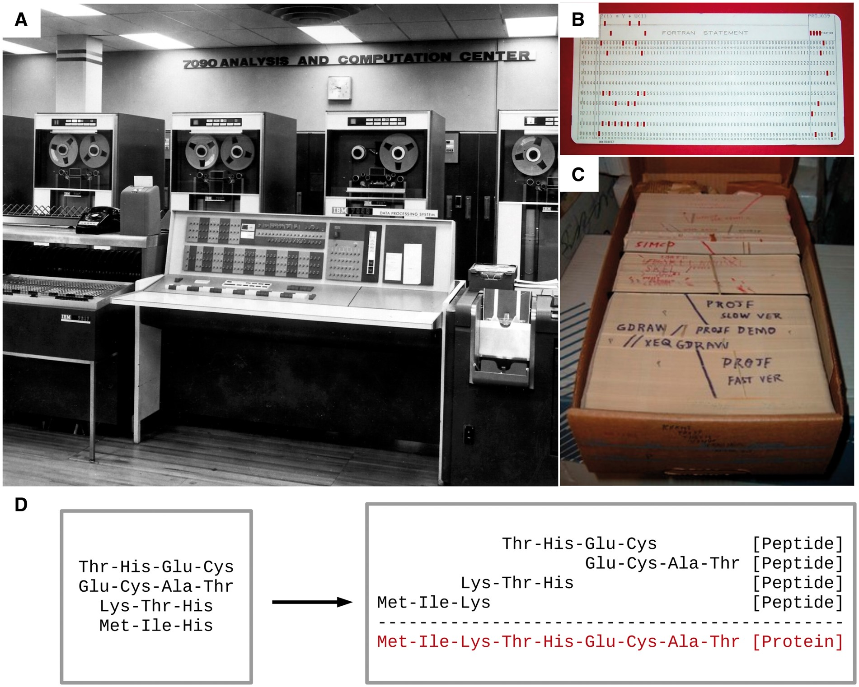
1950-1970s: The origins
Hints that DNA is the molecule of inheritance
Monomers in equimolar proportions
DNA double helix structure
Protein sequencing (top figure)
Protein sequence assembly (bottom figure)
Margaret Dayhoff: the mother and father of bioinformatics
Software: COMPROTEIN (1962)

Slide 25
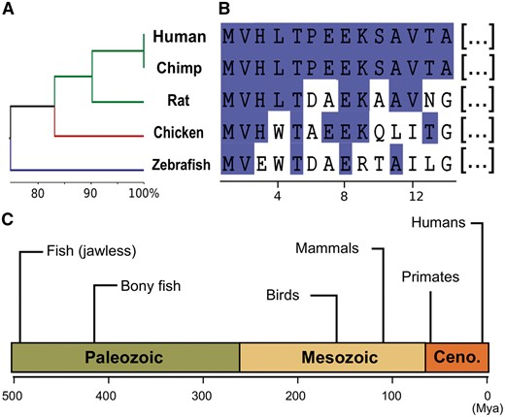
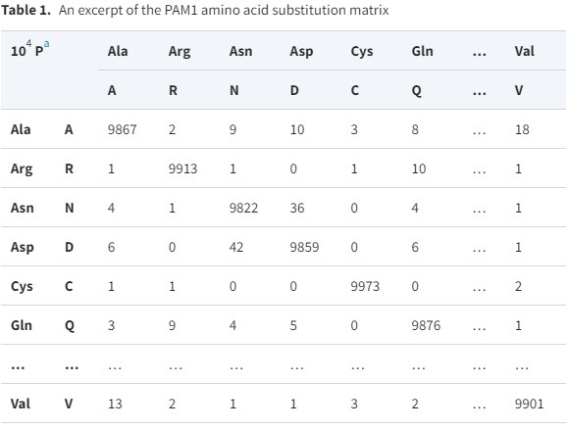
1950-1970s: The origins
“Paleogenetics” - evolutionary biology (top figure)
“common ancestor” of proteins
Needleman-Wunsch algorithm
Modeling amino acid substitutions (bottom figure)
All 64 codons deciphered

Slide 26
1970-1980: Paradigm shift from protein to DNA analysis
Central Dogma
DNA sequencing
Software: Staden (1979)
DNA phylogenetic methods
Felsenstein - major contributions

Slide 27
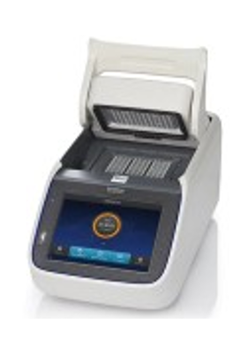
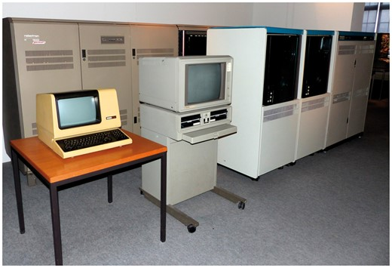
1980-1990: Parallel advances in biology and computer science
Endonucleases + DNA ligase
polymerase chain reaction (PCR)
1977: ready-to-use microcomputers
Commodore PET, Apple II, Tandy TRS-80
BASIC language
1984: U of Wisconsin - GCG software suite for sequence analysis

Slide 28
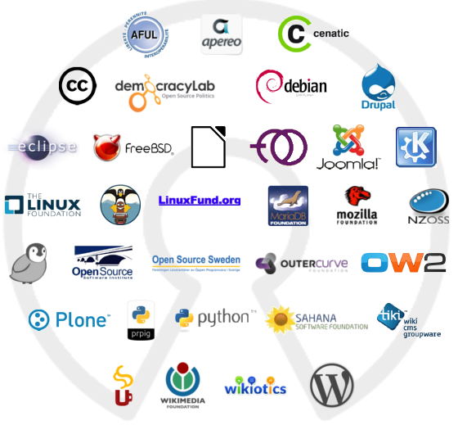
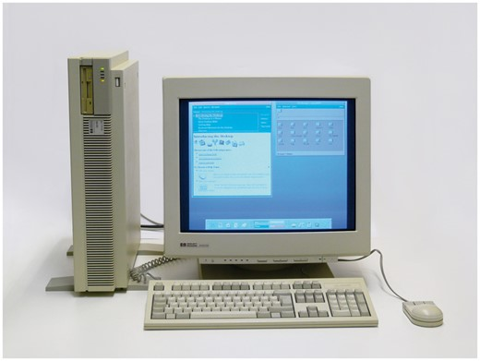
1980-1990: Parallel advances in biology and computer science
Bioinformatics and the free software movement
EMBOSS - open source alternative to GCG
Precursor to International Nucleotide Sequence Database Collaboration (INSDC)
Computer Applications in the Biosciences (CABIOS) - 1985
x86 and RISC computers
PERL scripting language
Notes:
Python scripting language was created in 1989 but not used in bioinformatics until about 2000

Slide 29
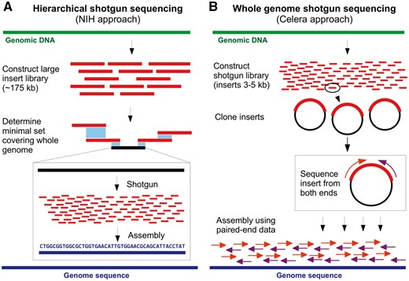
1990–2000: Genomics, structural bioinformatics and the information superhighway
Dawn of the genomics era
Crucial assembly software
GenBank and EMBL founded
Internet
Structural bioinformatics
Notes:
Dawn of the genomics era
H. influenzae 1995
Human genome project initiated in 1991
Drosophila melanogaster genome finished 2000
E. coli genome 1997
Crucial assembly software
PHRED/PHRAP, Celera assembler, TIGR assembler, MIRA, EULER
GenBank and EMBL founded
and other crucial databases

Slide 30
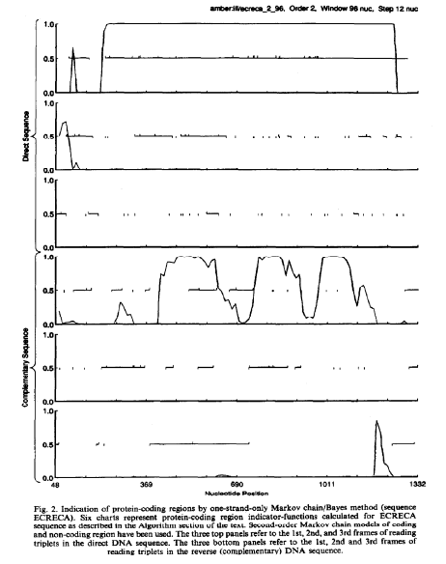
1990–2000: Genomics, structural bioinformatics and the information superhighway
Gene prediction
Open Reading Frames (ORFs)
Hidden Markov Models (HMMs)
Mark Borodovsky, James McIninch,
GENMARK: Parallel gene recognition for both DNA strands,
Computers & Chemistry,
Volume 17, Issue 2, 1993, Pages 123-133, ISSN 0097-8485, https://doi.org/10.1016/0097-8485(93)85004-V.

Slide 31
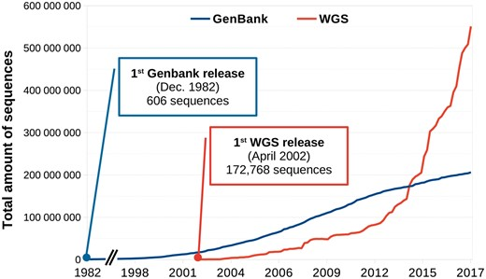
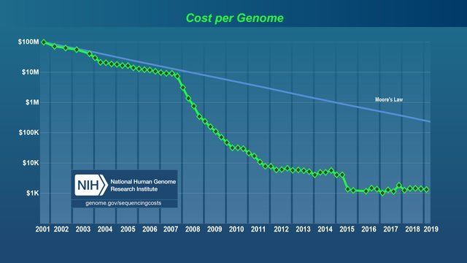
2000-2010: High-throughput bioinformatics
Second-generation sequencing
AKA, next-generation sequencing (NGS)
Explosion of sequence data
Model organism databases
Sequence Read Archive (SRA); European Nucleotide Archive (ENA)
High performance computers (HPC)
Notes:
NGS methods: 454, Illumina, SOLiD
Specialized databases like Drosophila, Saccharomyces, human
HPCs: Compute Canada, NY state, …, AWS, Azure
What Is Moore's Law?
Moore's Law refers to Gordon Moore's perception that the number of transistors on a microchip doubles every two years, though the cost of computers is halved. Moore's Law states that we can expect the speed and capability of our computers to increase every couple of years, and we will pay less for them. Another tenet of Moore's Law asserts that this growth is exponential.

Slide 32
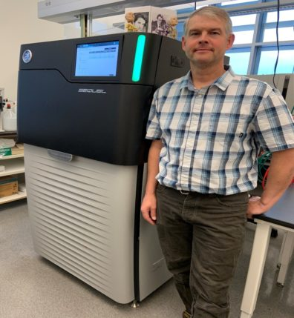
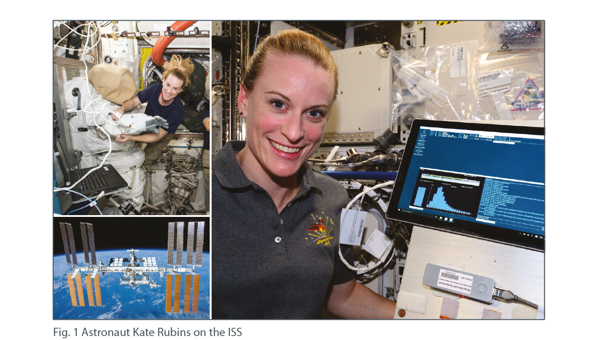
2010 - Today: present and future perspectives
Defining “bioinformatician”
Third generation sequencing
PacBio
Oxford Nanopore
Notes:
https://nanoporetech.com/resource-centre/dna-sequencing-microgravity-international-space-station-iss-using-minion
Fig. 1 Astronaut Kate Rubins on the ISS
The first ever sequencing in space was performed on the ISS by Kate Rubins
The portability of the MinION allows users to sequence in non-laboratory situations. To demonstrate this, in collaboration with NASA, we tested the MinION aboard the ISS. The ISS orbits 400 km above the Earth, and travels at approximately 28,000 km/h and so is in constant freefall, with a continuous microgravity environment (Fig. 1). A mixture of lambda phage, mouse and E. coli DNA libraries was prepared on Earth and was sequenced on the ISS over four MinION runs. The same mixture of libraries was sequenced over four MinION runs on Earth, to act as a control.

Slide 33

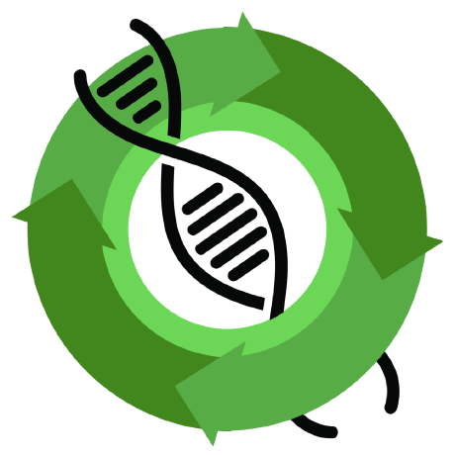
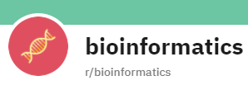



2010 - Today: present and future perspectives
Community
Online tools, libraries
Local Tools
Notes:
Community
BioStars
SeqAnswers
rosalind.info
bioinformatics subreddit
Online tools, libraries
Galaxy
BioJS
Local Tools
EuGene

Slide 34
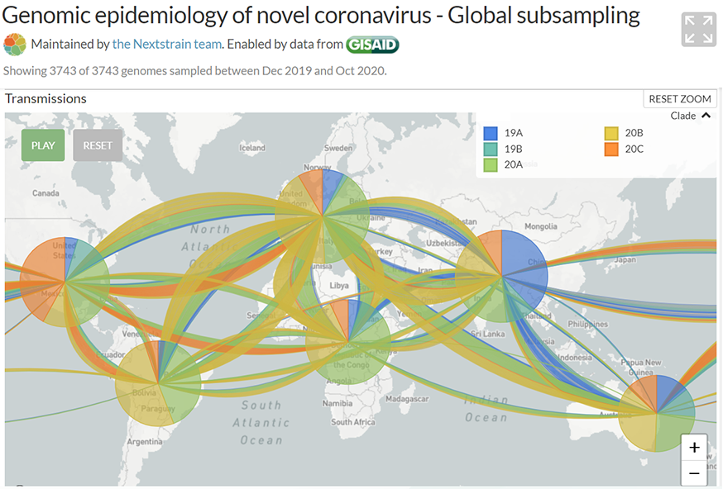
2015 - today: Biological applications
Genomic epidemiology
Population structure
Antimicrobial resistance monitoring
Source: https://nextstrain.org/ncov/global?c=clade_membership&r=region
Notes:
Genomic epidemiology
PulseNet
GenomeTrackr
Gen-FS
GISAID
etc

Slide 35

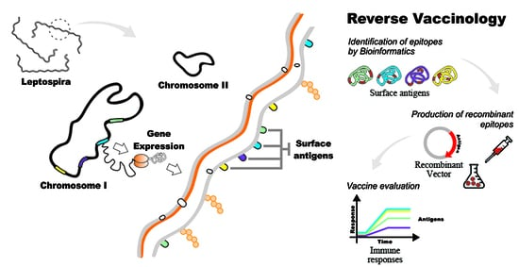
2015 - today: Biological applications
Infectious disease “weather map”
Wastewater, e.g., NWSS
BioWatch
Environmental sampling
Reverse vaccinology
Drug development
Source: https://www.mdpi.com/1422-0067/18/1/158

Slide 36
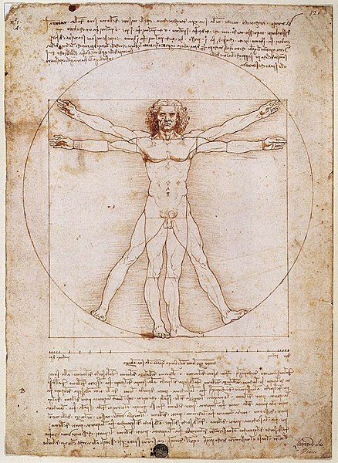
2015 - today: Biological applications
Bioremediation
Human genomics
Disease predictions
Personalized medicine
Gene therapy
Agriculture
Biodefense
Evolutionary studies

Slide 37
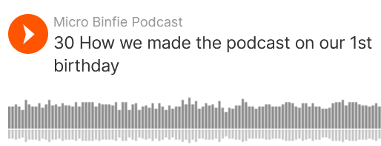
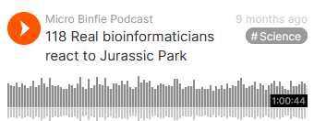

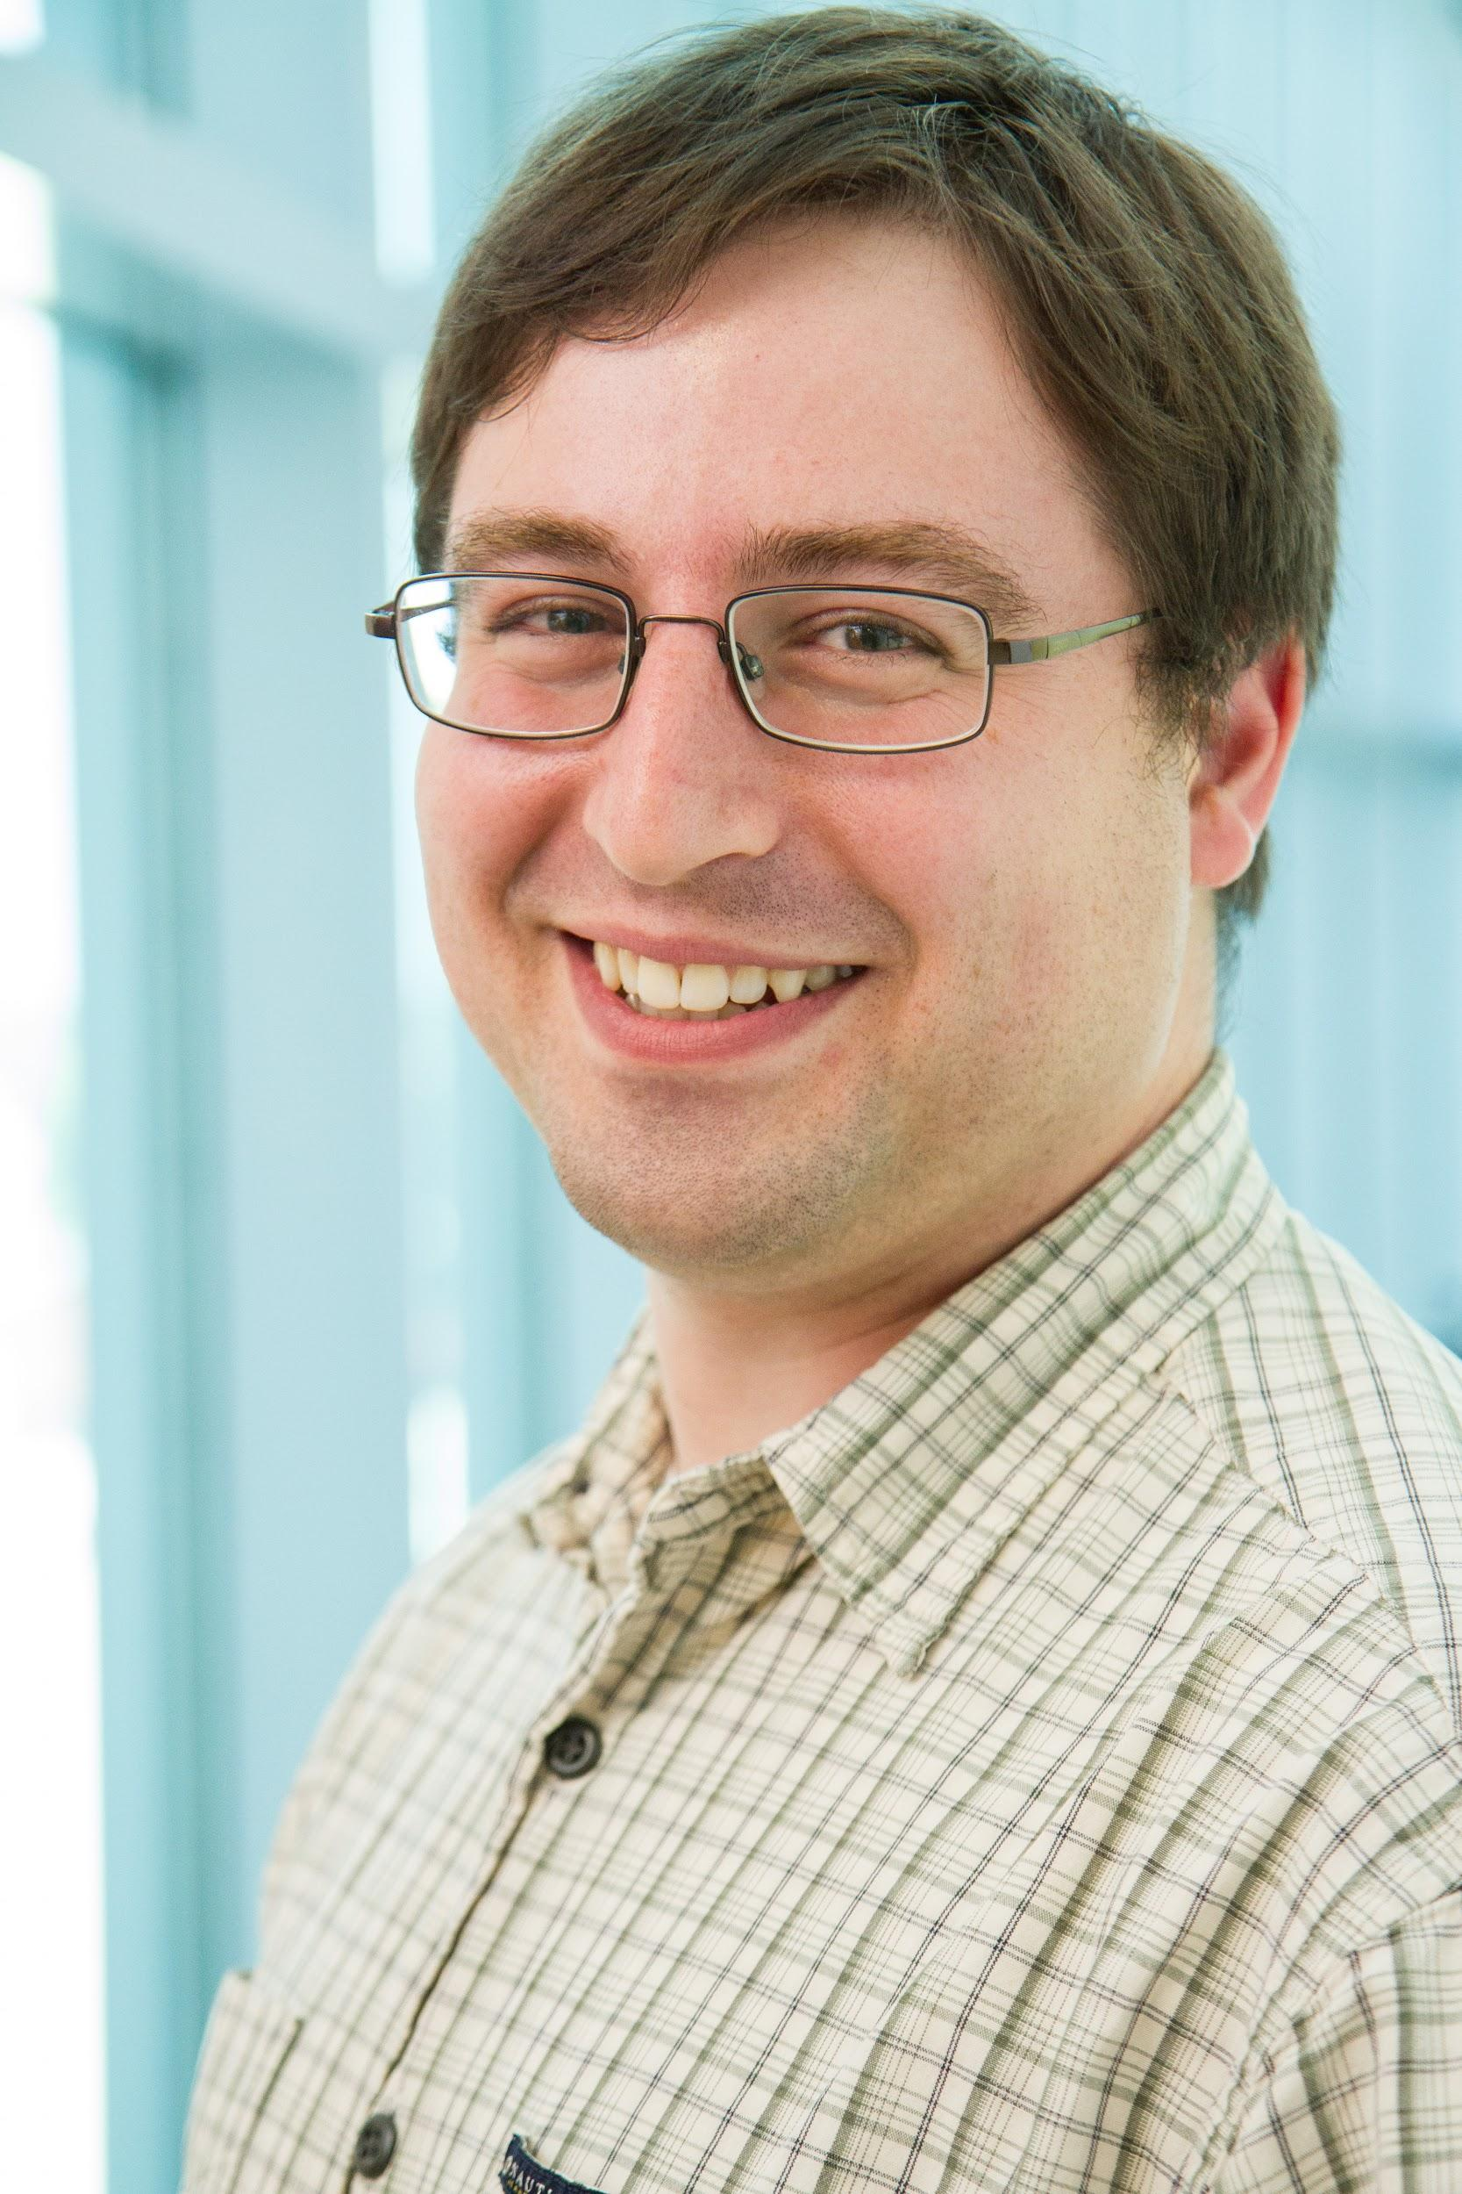
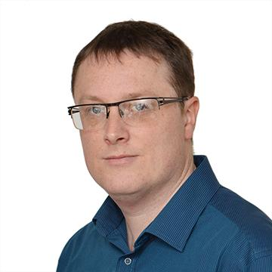
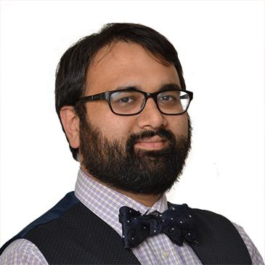
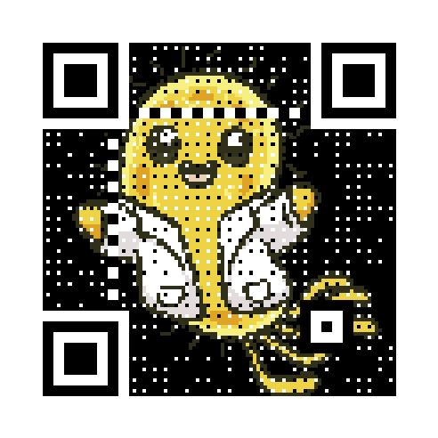

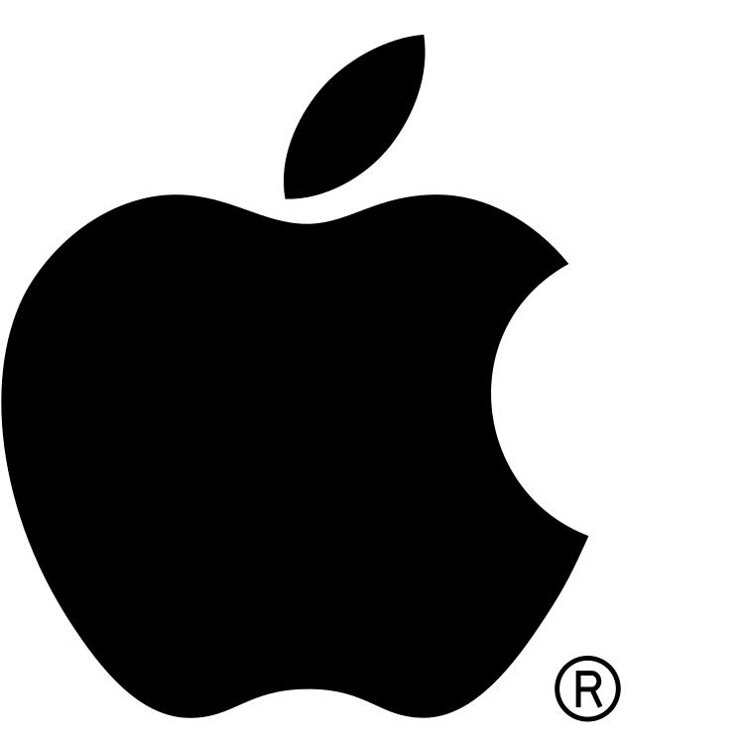


Microbial Bioinformatics is a rapidly changing field marrying computer science and microbiology. Join us as we share some tips and tricks we’ve learnt over the years.
If you’re getting to grips to the field, or someone who wants to keep tabs on the latest and greatest - this podcast is for you.
Your Hosts
Lee Katz
Andrew Page (Theiagen)
Nabil Alikhan (University of Oxford)
https://microbinfie.github.io
Listen on Apple iTunes
Listen on Spotify
RSS
Notes:
Microbial Bioinformatics is a rapidly changing field marrying computer science and microbiology. Join us as we share some tips and tricks we’ve learnt over the years.
In 2019, we wanted to get our ideas out into the public and were trying to think – a zine? A blog? How would we talk about current bioinformatics topics in the best way? We agreed to do a podcast format with one episode about every two weeks.
If you’re getting to grips to the field, or someone who wants to keep tabs on the latest and greatest - this podcast is for you.
One of my favorite episodes is real bioinformaticians react to Jurassic Park but you can also start at the trailer.

Slide 38
Professional advice
I’ll try to give professional advice throughout the course

Slide 39
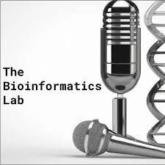
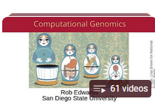
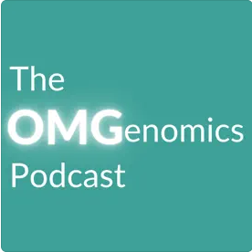
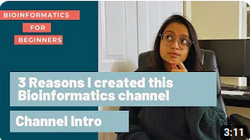
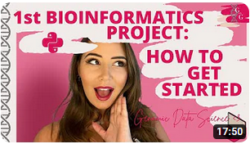
Like and subscribe 🔔
Rob Edwards’s class
Bioinformatics with Georgia
Bioinformagician

Slide 40
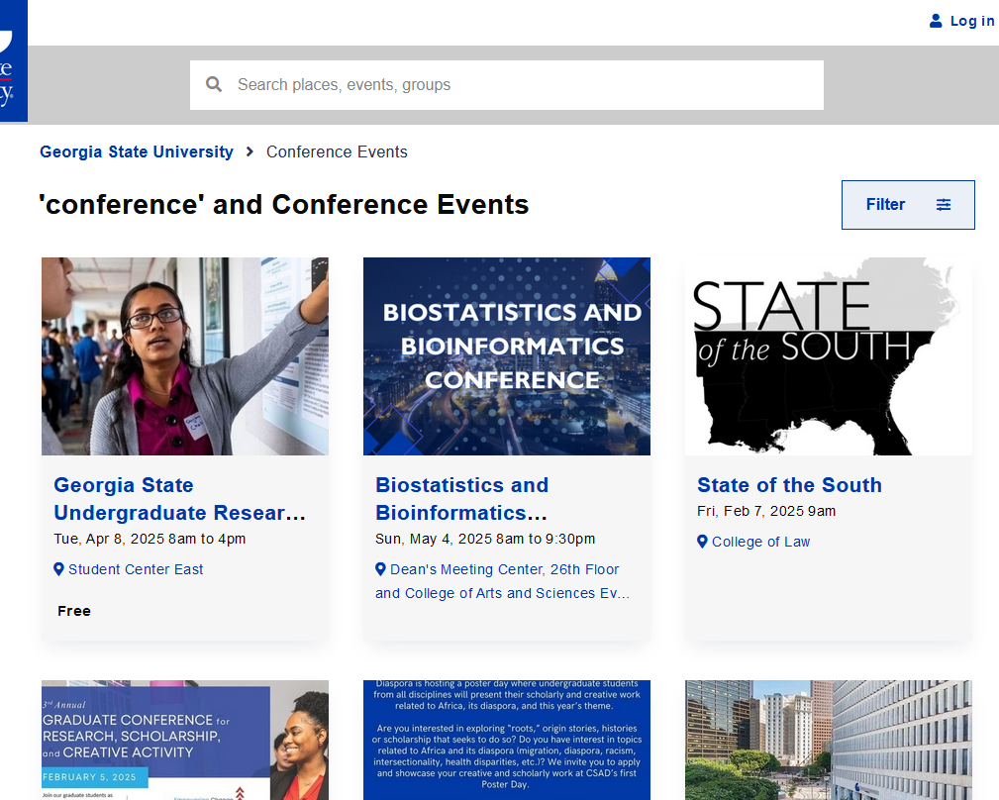
Stay on top of GSU events
https://calendar.gsu.edu/search/events?search=conference&order=score&start_date=2025-01-13&days=365&experience=inperson&event_types%5B%5D=114694

Slide 41
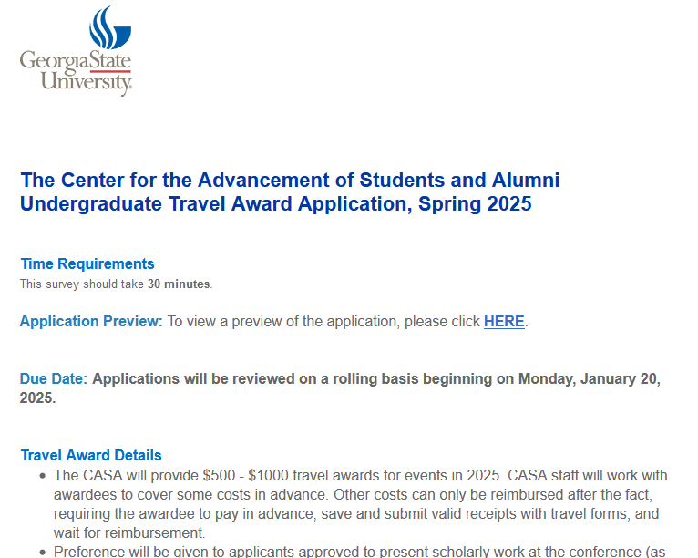
Travel award for undergrads 2025
https://gsu.qualtrics.com/jfe/form/SV_0I2wKgN9MwdW8IK

Slide 42







Questions?
Lee Katz
lkatz@gsu.edu
@lskatz.bsky.social
@lskatz
https://mstdn.science/@Lskatz
github.com/lskatz
microbinfie.github.io
lskatz.github.io
X

